Slide 1
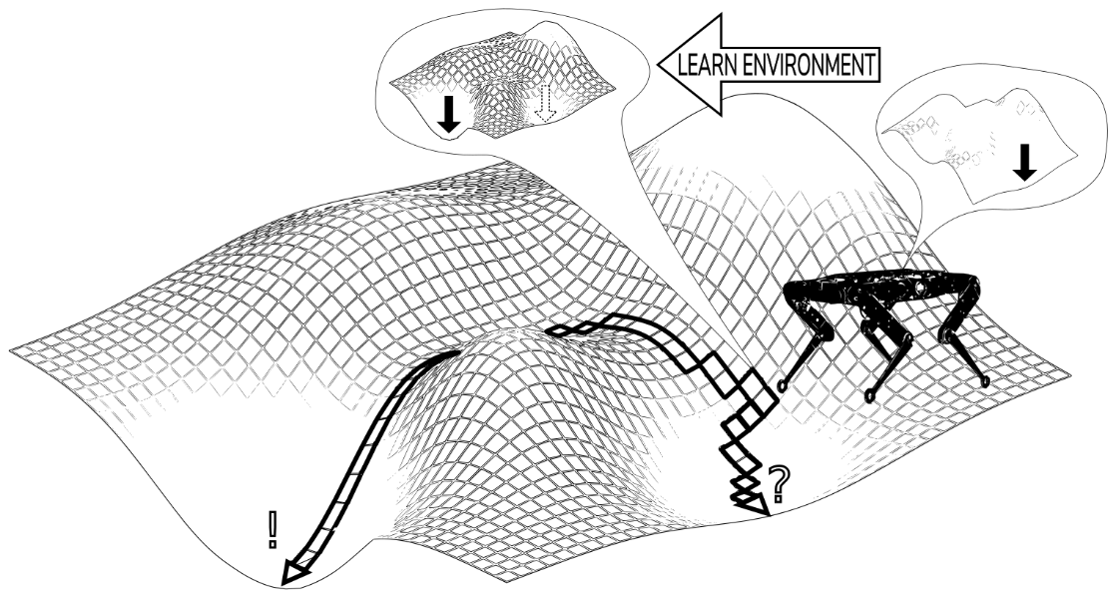
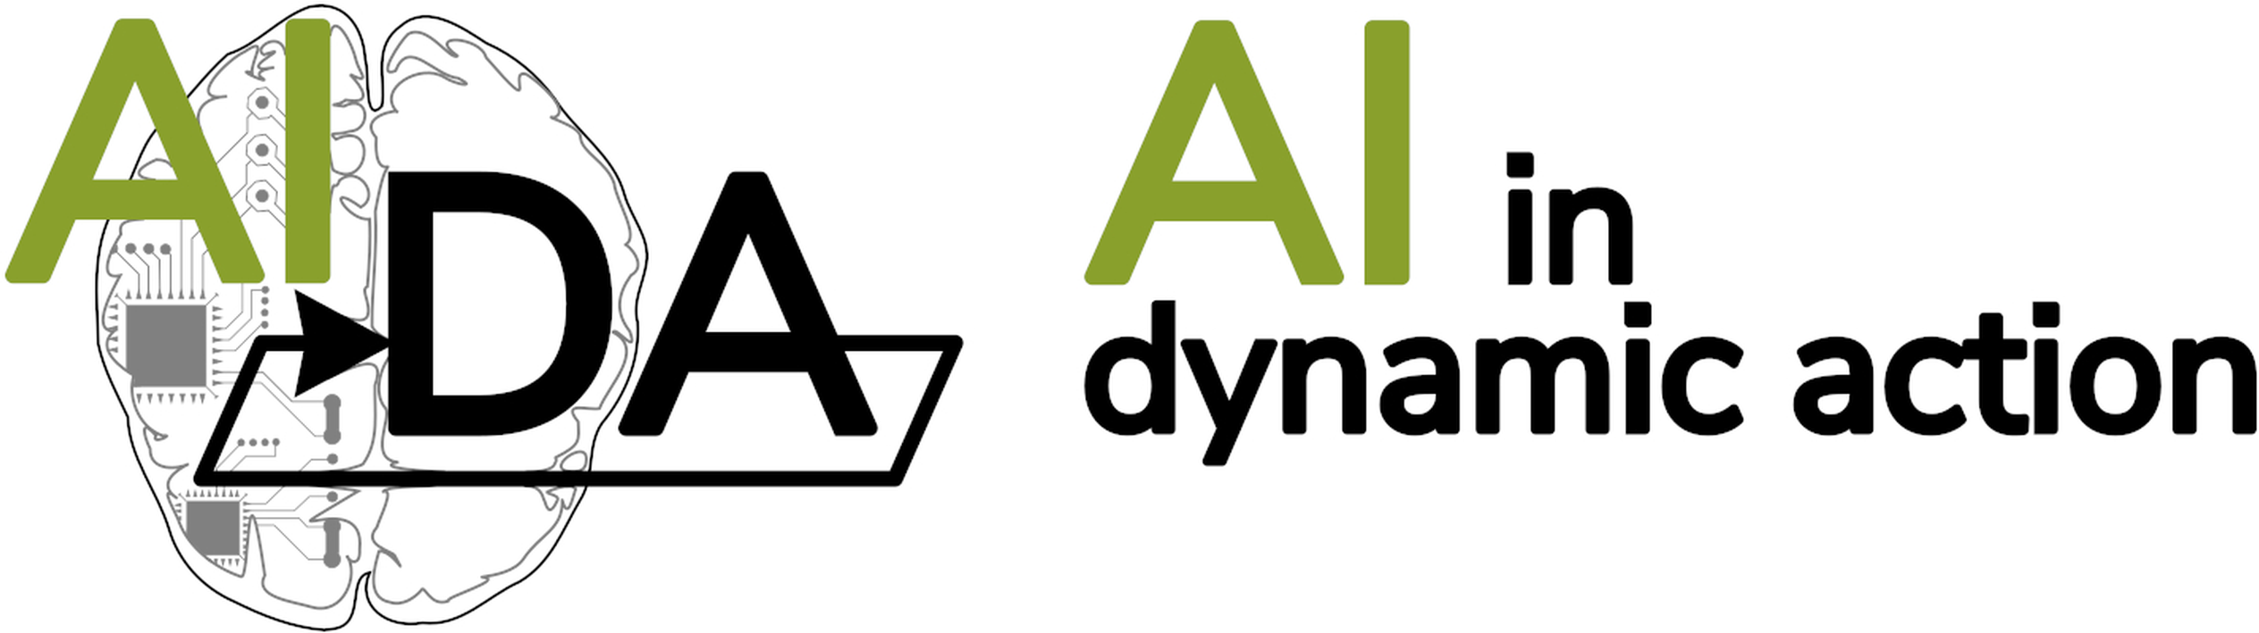
Seminar 1: Terminology
Skolkovo Institute of Science and Technology
Notes:
Alright, everyone. Today we’re going to have a seminar on reinforcement learning terminology. You might be surprised that we’re about to dedicate several hours to terminology, but, you see… Reinforcement learning is a leviathan of a discipline. There’s just so much going on. RL agents, RL enivironments, RL methods, different kinds of objectives, data, dynamics, diverse mathematical apparatus and so on. And all of these things have their own relevant terminology that is used to draw distinctions, so that one could reason about them.
So there’s just a great deal of terminology that one has to know to be able to navigate even the most simple of topics. Of course, you could just try to learn new terms on the fly, but you’ll soon find that the sheer amount of jargon can be overwhelming, and if you briefly forgot what a certain term means, then, naturally, you can no longer follow. Besides it is nice to spend some time reflecting on the core terminology, because you will get a better idea of what makes up the discipline of reinforcement learning. I know some of you might already feel a bit overwhelmed. This is, because you still don’t have a clear picture of what’s going with all these new concepts that you’re beginning to discover. And this seminar is designed to help you out. To let you develop a better understanding and intuition of those concepts.

Slide 2
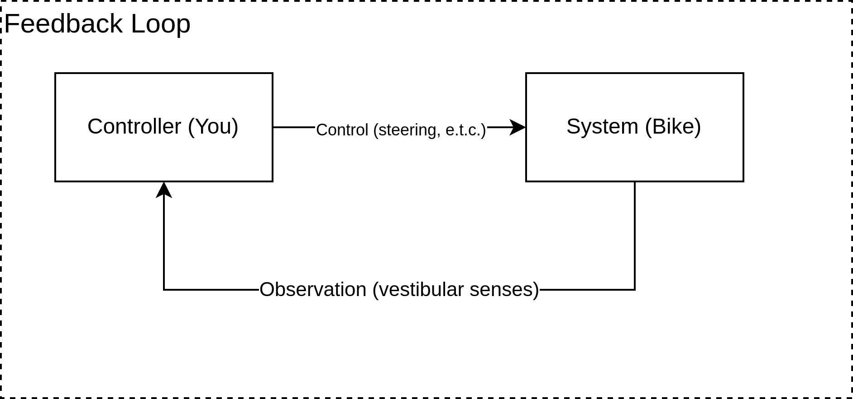
Feedback control
Notes:
On this diagram you can see the representation of learning how to ride a bike. You use your senses to observe it, you use your hands and legs to perform actions, and what you’re probably trying to minimize is injuries. This is also an example of a scenario when “RL agent” means the same thing as “controller”, “RL environment” means the same thing as “control-system” and so on. Please, raise your hand if you know how to ride a bike. Wowsers, turns out I’m not the only one. Now, please, raise your hand if it was your dad, who taught you how to ride a bike. Right. You, sir, please come over here. *Now, can you, please, in more detail describe the process of how your dad taught you to ride a bike. So, actually from your experience of learning you can tell that this diagram is in fact highly inaccurate. Because if this were the case, then where does DAD fit in. So, if we were to correct this diagram, then it would probably look something like this.
<number>

Slide 3
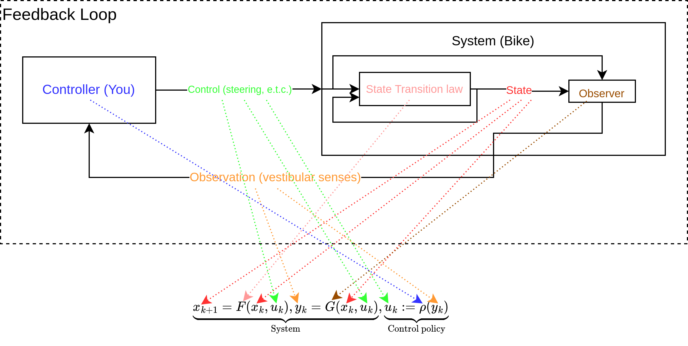
Feedback control
Notes:
On this diagram you can see the representation of learning how to ride a bike. You use your senses to observe it, you use your hands and legs to perform actions, and what you’re probably trying to minimize is injuries. This is also an example of a scenario when “RL agent” means the same thing as “controller”, “RL environment” means the same thing as “control-system” and so on. Please, raise your hand if you know how to ride a bike. Wowsers, turns out I’m not the only one. Now, please, raise your hand if it was your dad, who taught you how to ride a bike. Right. You, sir, please come over here. *Now, can you, please, in more detail describe the process of how your dad taught you to ride a bike. So, actually from your experience of learning you can tell that this diagram is in fact highly inaccurate. Because if this were the case, then where does DAD fit in. So, if we were to correct this diagram, then it would probably look something like this.
<number>

Slide 4
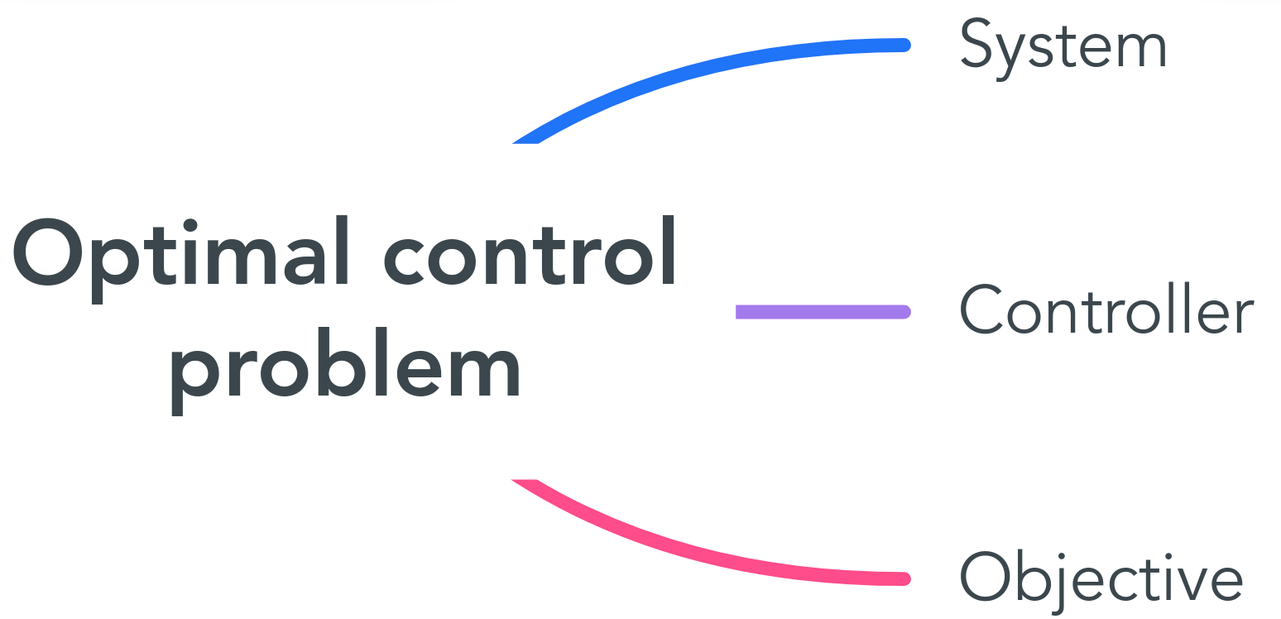
Problems related terminology
Notes:
Let’s first discuss problems related terminology. So notice, how I said “RL methods” but I deliberately avoided saying “RL problems”. This is because there is no such thing as RL problems. Since “RL methods” are just a family of approaches for solving optimal control problems. There are of course other approaches beyond reinforcement learning. An optimal control problem consists of a control-system that we act upon and an objective that we desire to optimize. Both of these have several aspects that determine the specifics of the problem we’re dealing with.
<number>

Slide 5

Problems related terminology
System
Objective
Minimize the time it takes to reach your destination.
Notes:
Let’s first discuss problems related terminology. So notice, how I said “RL methods” but I deliberately avoided saying “RL problems”. This is because there is no such thing as RL problems. Since “RL methods” are just a family of approaches for solving optimal control problems. There are of course other approaches beyond reinforcement learning. An optimal control problem consists of a control-system that we act upon and an objective that we desire to optimize. Both of these have several aspects that determine the specifics of the problem we’re dealing with.
<number>

Slide 6
Please, split into groups of three.
Notes:
Alright. Now, I’ll give you a couple of minutes to split into groups of three. And if it so happens that after two minutes you still didn’t manage to find yourself a team, then I will, ofcourse, instantly expel you from Skoltech. If you’re attending online you can just stay in groups of 1. Alright now, get cracking. *** Ok, time is up. Did you all find yourself a team. Are you sure? Ok, if it turns that you’re on your own once we start doing stuff, it’s just gonna be really awkward.
<number>

Slide 7
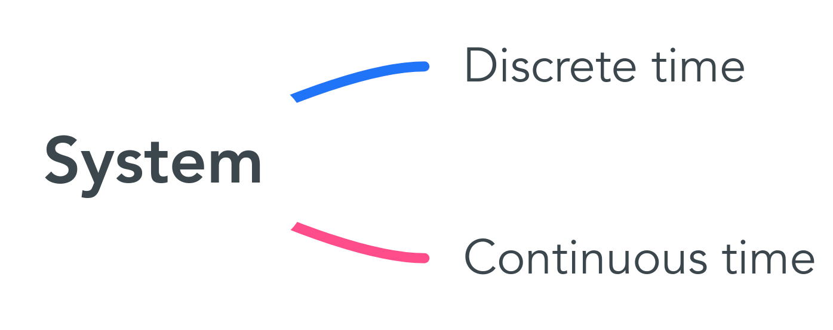
Discrete time vs. Continuous time
Notes:
For instance, we have discrete time systems and we have continuous time systems. This one is pretty straight forward. Discrete time is when time is modeled by integers and continuous is when it’s modeled by reals. In discrete systems you use the current state of the systems to determine it’s state at the next step. With continuous time there really is no such thing as “the next step”, so things get a bit more complicated.
<number>

Slide 8
Discrete time vs. Continuous time
State dynamics function
Continuous:
Discrete:
State transition function
Notes:
For instance a common way to describe a continuous system is by constructing a differential equation of the kind that you see on top right here. The right hand side of this differential equation determines in which direction of the statespace the system’s state drifts. Thus by picking an adequate control input $u$, you can influence the direction in which the state is moving. In discrete time it’s much simpler that that. Your control input determines precisely to which state you’re about to jump next. These two examples illustrate how continuous time settings differ from those of discrete time. By the way, in a discrete system this F function on the right hand side is called a state transition function, whereas in the continuous case it would be called a state dynamics function. And there’s a good reason for it, because, as we just discussed, their geometrical meanings are very different. It is important to note that not all continuous-time systems are like this. And not all discrete-time systems are like this either. There is actually a certain property that the two of these systems share, that other systems might very well not posses. And what would that be? Please, raise your hand if you know what these two systems have in common. ** Alright, I’ll give you three minutes to discuss it in your groups. ## domain of the state transition function
<number>

Slide 9
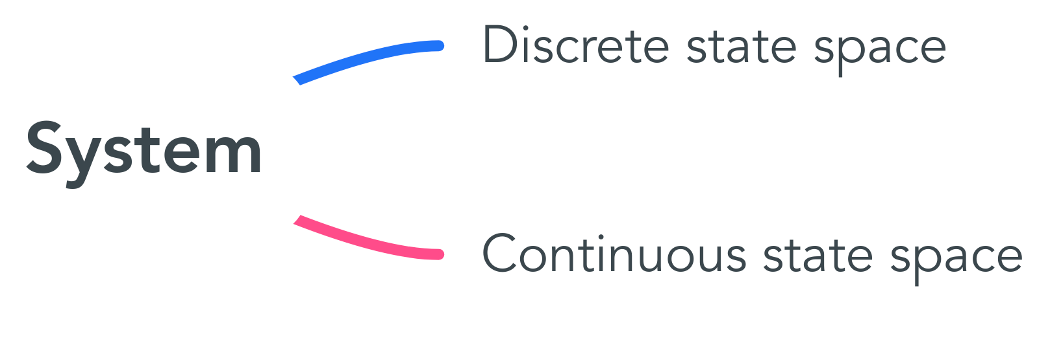
Discrete state space vs. Continuous state space
Notes:
Ofcourse, what the latter two systems did share was the nature of their state-space. Just like time can be either discrete and continuous, the state-space too can be either discrete or continuous. Rigorously speaking, you call the state-space discrete if it has either a finite or a countable number of elements. Whereas a continuous state space is normally a manifold of some kind. Well, actually you can in fact construct certain bizarre examples of an uncountable state-space that nonetheless deserves to be called discrete, due to some formal nuances in topology, but you are unlikely to ever come across anything like this ever… in any paper. I’m saying this for those of you that did study topology, so that you don’t become confused about this choice of definitions.
<number>

Slide 10
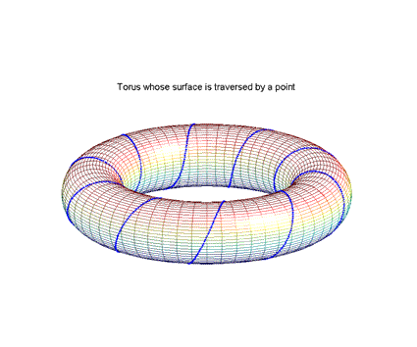
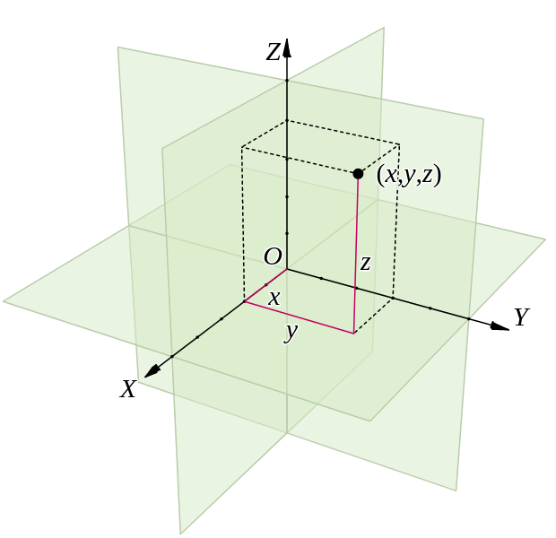
Continuous state space
Notes:
Let’s take a look at some discrete state spaces.
<number>

Slide 11
Discrete state space
?
Notes:
Let’s take a look at some discrete state spaces.
<number>

Slide 12
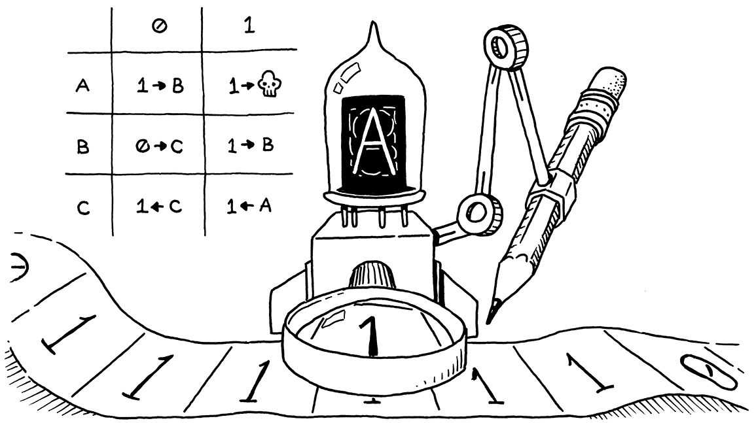
Discrete state space
Notes:
Let’s take a look at some discrete state spaces.
<number>

Slide 13
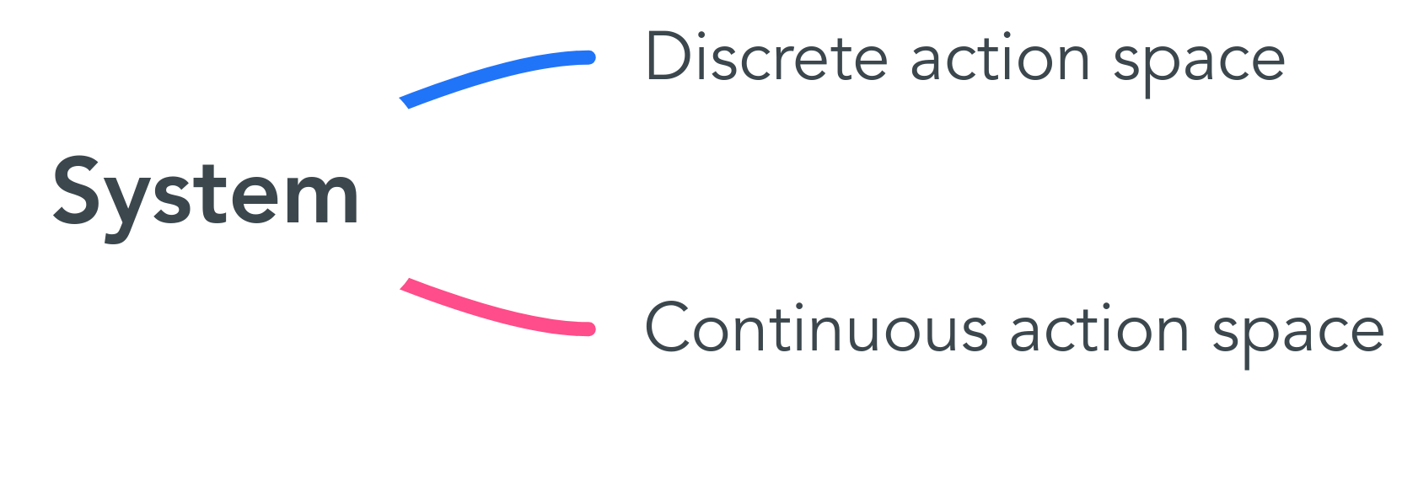
Discrete action space vs. Continuous action space
Notes:
Let’s take a look at some discrete state spaces.
<number>

Slide 14


Discrete action space vs. Continuous action space
Continuous
Discrete
Notes:
Let’s take a look at some discrete state spaces.
<number>

Slide 15

Discrete action space with continuous time and state space
Notes:
Let’s take a look at some discrete state spaces.
<number>

Slide 16
Continuous action space with discrete time and state space
?
Notes:
Try to construct an example of such a system or, alternatively, you can also try to simply mathematically phrase a reasonable class of control-systems that posses this property.
<number>

Slide 17

Continuous action space with discrete time and state space
Notes:
You’re probably wondering why I didn’t just give you a real world example of such a system. And the reason why is: that such examples are ugly and complicated.
<number>

Slide 18
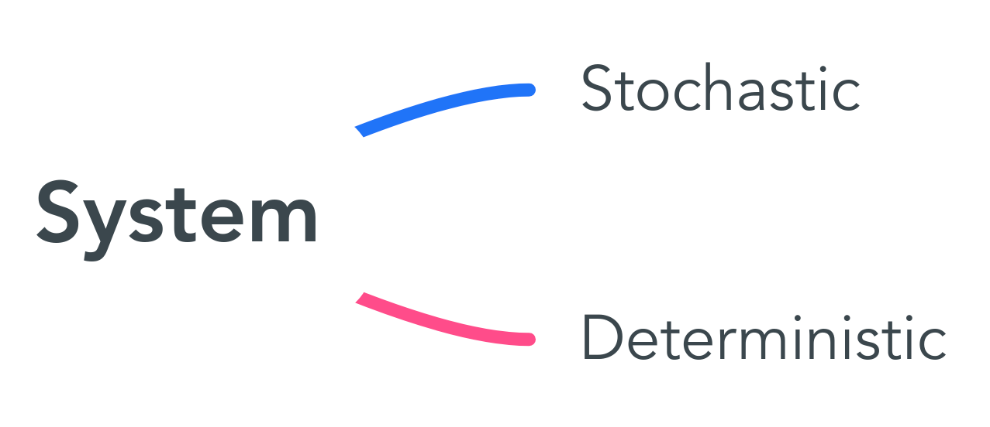
Stochastic vs. Deterministic
Notes:
<number>

Slide 19
Stochastic systems
?
Notes:
Now, I’ll give you two minutes to come up with a stochastic control system in your groups of three.
<number>

Slide 20
Stochastic systems
Pretty much anything
Notes:
It was a bit of a silly question, because the harsh reality of engineering application is that stochastic is pretty much omnipresent. I some sense, all systems that we observe behave randomly to some degree. It’s just that sometimes this randomness is negligble, and thus in this case we neglect it, so that we could view the system as a deterministic one.
<number>

Slide 21
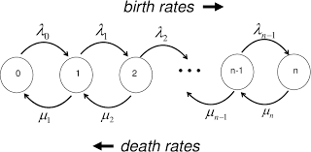
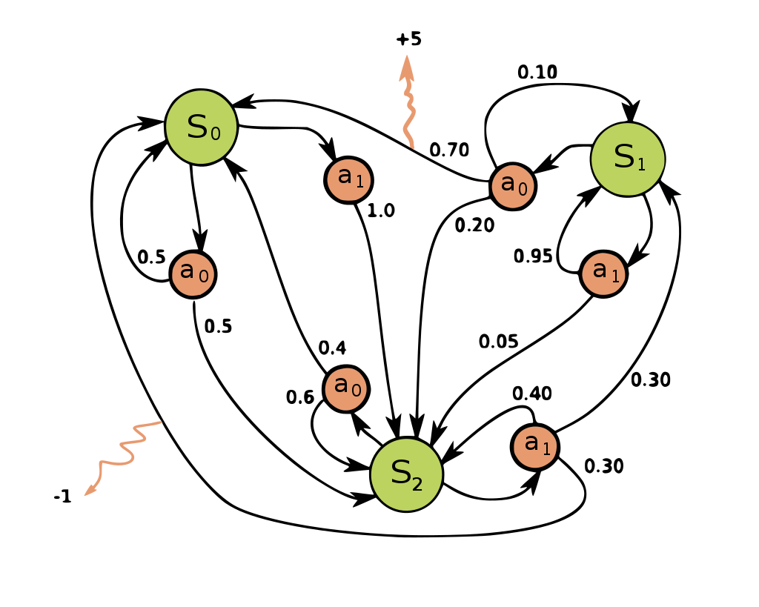
Stochastic systems
Continuous state space
Discrete state space
Continuous time
Discrete time
Notes:
Stochastic differential equiations.
<number>

Slide 22
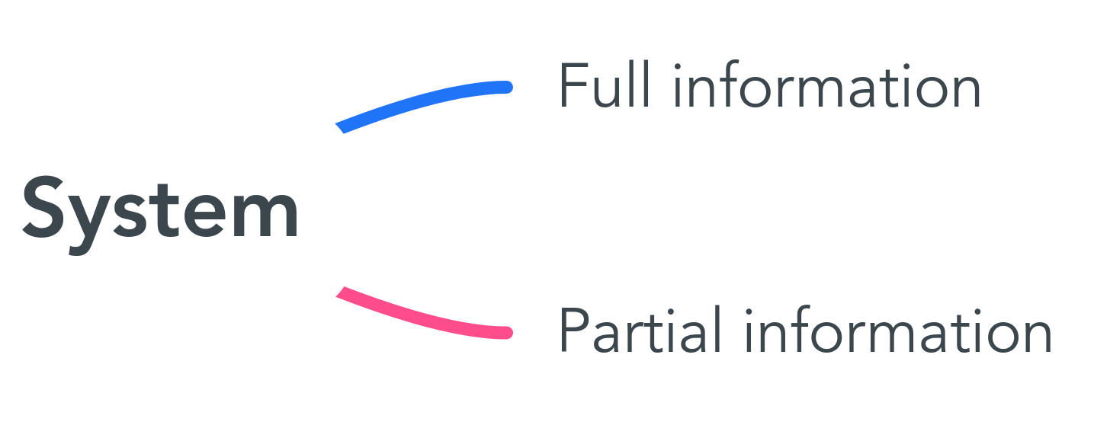
Full information vs. Partial information
Notes:
<number>

Slide 23
Full information vs. Partial information
Observation State
Notes:
<number>

Slide 24
Full information vs. Partial information
Full information
Observation State
Partial information
Observation State
Notes:
<number>

Slide 25
Partial information examples
Full information
Partial information
Notes:
<number>

Slide 26
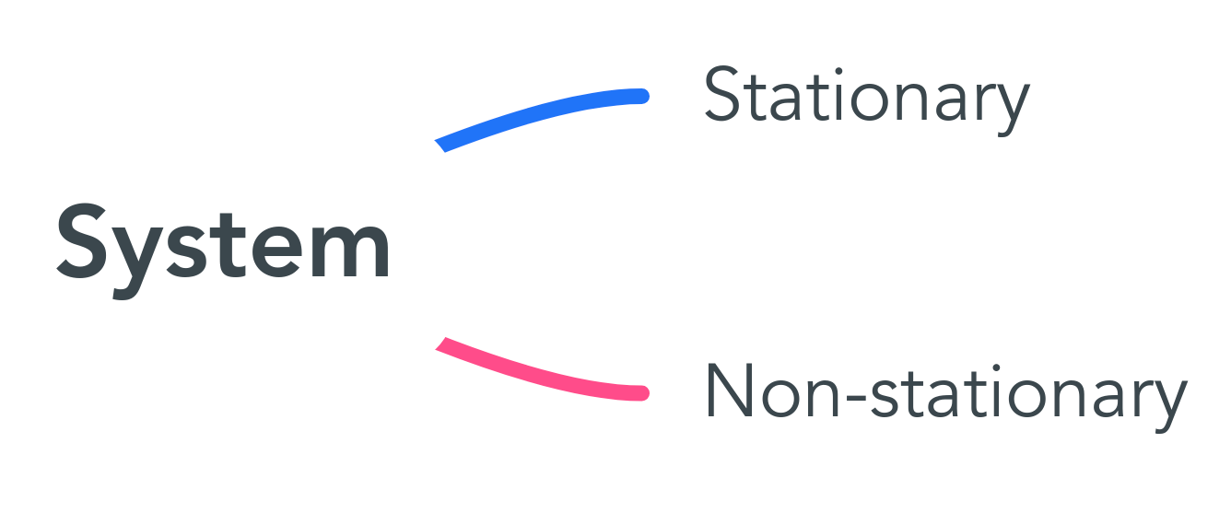
Stationary vs. Non-stationary
Notes:
<number>

Slide 27
Stationary vs. Non-stationary
Non-stationary
Stationary
Notes:
<number>

Slide 28
Non-stationary --> stationary
Notes:
<number>

Slide 29
Example of a non-stationary system
?
Notes:
<number>

Slide 30
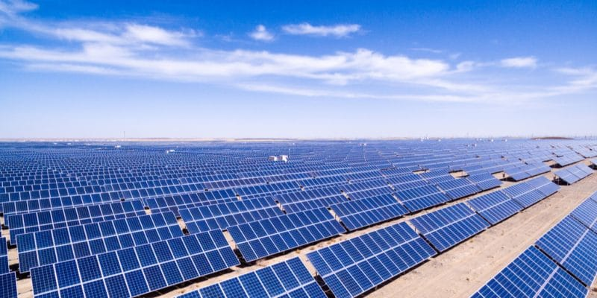
Example of a non-stationary system
Notes:
Solar power plant
<number>

Slide 31
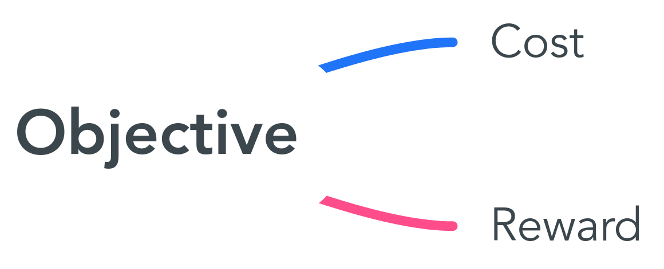
Cost vs. Reward
Notes:
Solar power plant
<number>

Slide 32
Cost vs. Reward
Cost
Minimize
Reward
Maximize
Notes:
Solar power plant
<number>

Slide 33
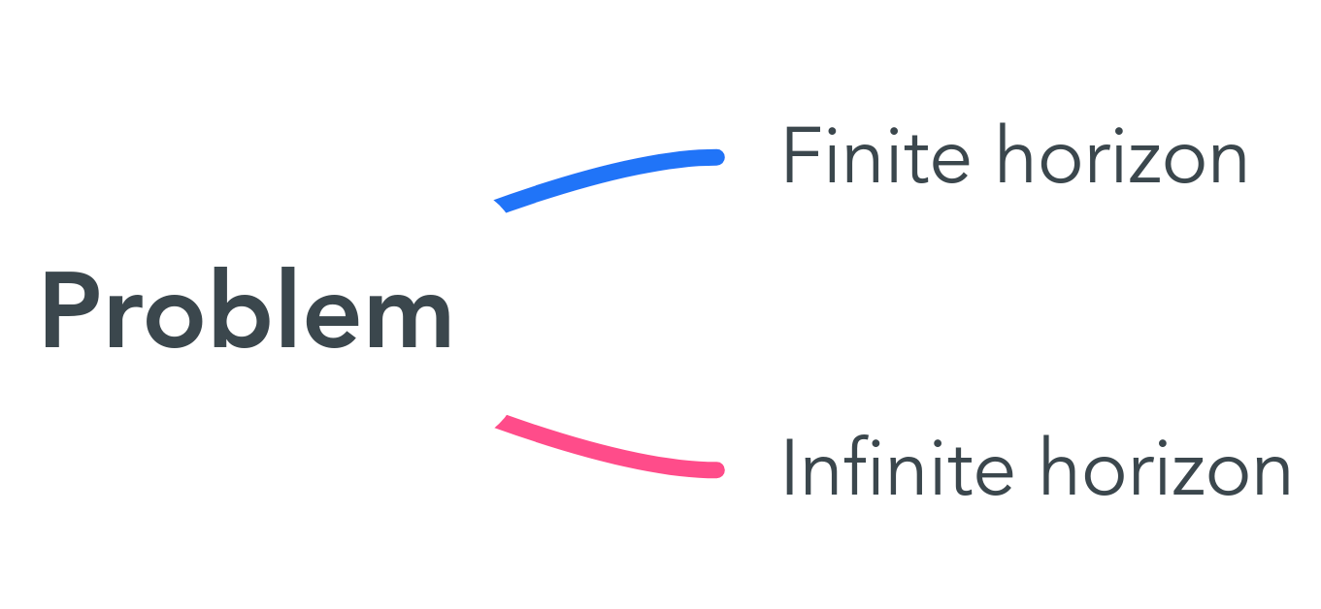
Finite horizon vs. Infinite horizon
Notes:
Solar power plant
<number>

Slide 34
Finite horizon vs. Infinite horizon
Finite-horizon
Infinite-horizon
You optimize the objective over a finite time frame.
You optimize the objective over an infinite time frame. (As if your RL agent were to run for all eternity)
Notes:
Solar power plant
<number>

Slide 35
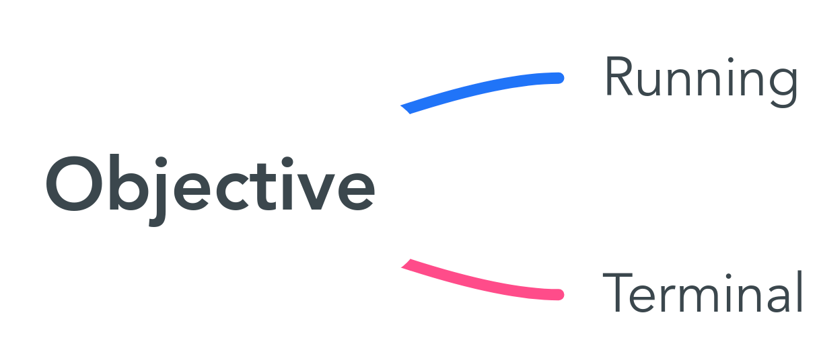
Running vs. Terminal
Notes:
Solar power plant
<number>

Slide 36
Running vs. Terminal
Running objective
Terminal objective
Notes:
Solar power plant
<number>

Slide 37
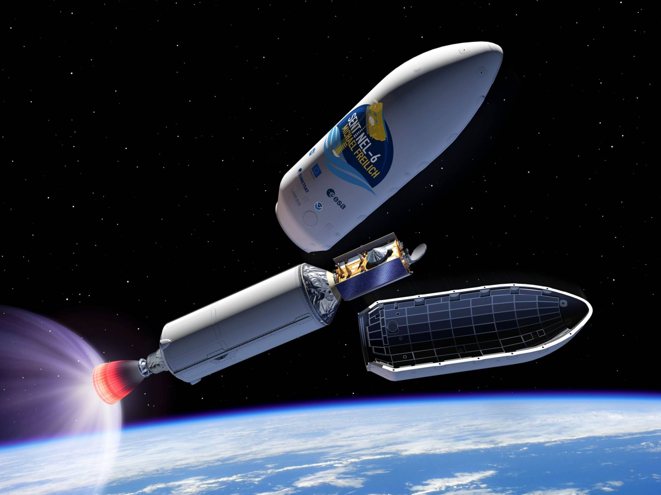
Terminal objective
Notes:
Solar power plant
<number>

Slide 38
Running objective
?
Notes:
Solar power plant
<number>

Slide 39
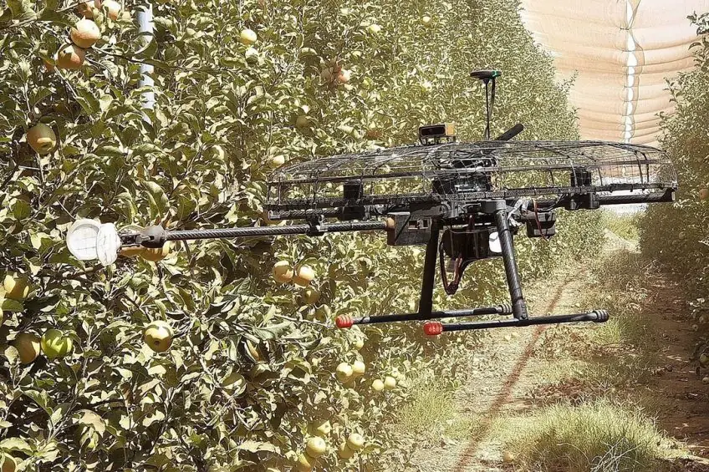
Running objective
Notes:
Solar power plant
<number>

Slide 40
Running --> Terminal
Notes:
Solar power plant
<number>

Slide 41
Terminal --> Running
Notes:
Solar power plant
<number>

Slide 42
Q&A
Notes:
Solar power plant
<number>

